Slide 1

Combinational Logic
Analysis
Chapter 5
Week 1
Sumaiyah Zahid

Slide 2
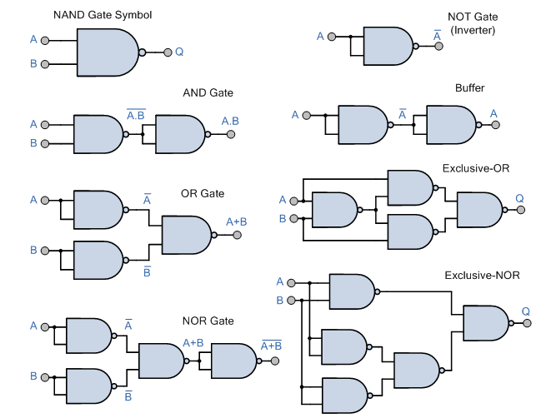
NAND Gate As a Universal Gate

Slide 3
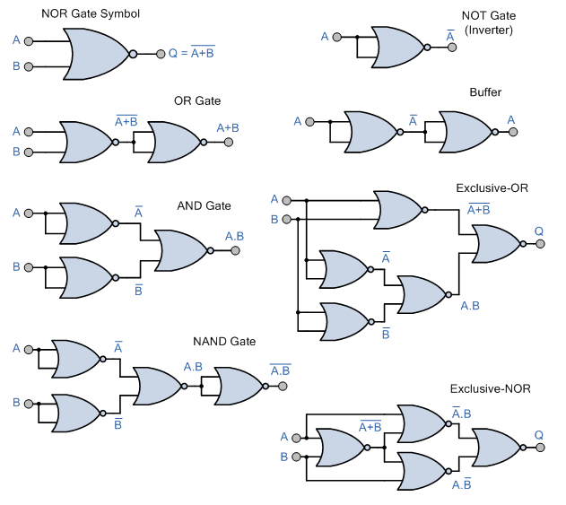
NOR Gate As a Universal Gate

Slide 4
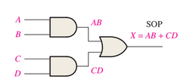
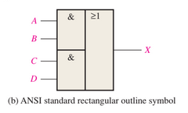
AND OR Logic
An AND-OR circuit directly implements an SOP expression, assuming the complements (if any) of the variables are available.

Slide 5
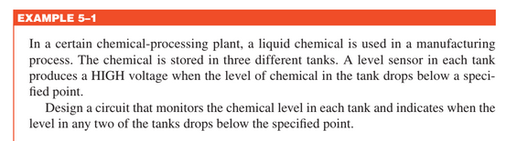
AND OR Logic

Slide 6
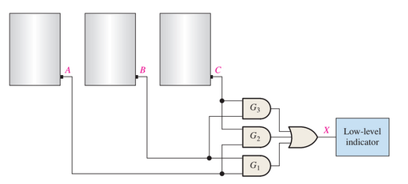

Slide 7
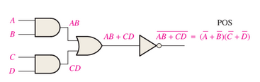
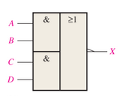
AND OR INVERT Logic
POS expressions can be implemented with AND-OR-Invert logic.

Slide 8
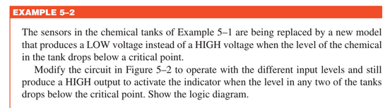
AND OR INVERT Logic

Slide 9
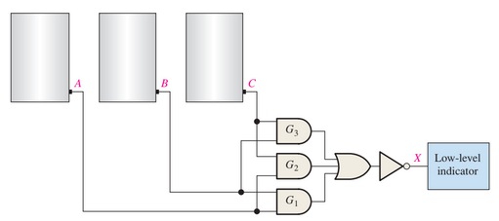

Slide 10

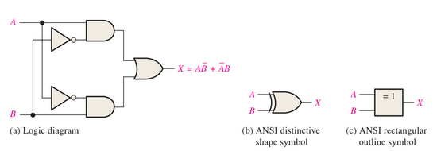
EXCLUSIVE-OR Logic

Slide 11
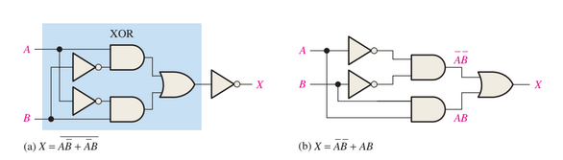
EXCLUSIVE-NOR Logic

Slide 12

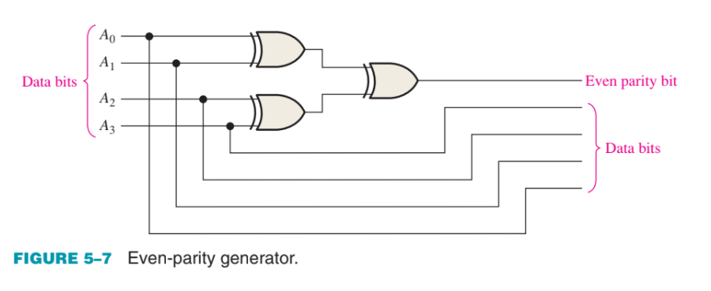
EXCLUSIVE-OR Logic

Slide 13
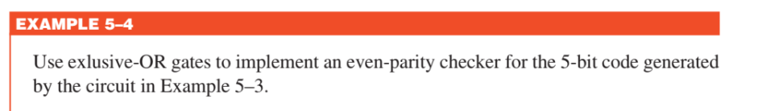
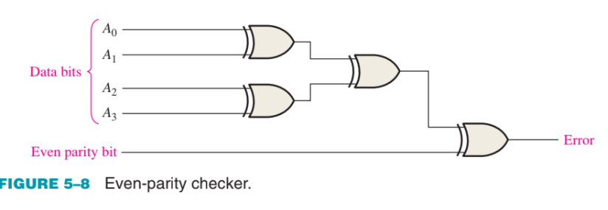
EXCLUSIVE-OR Logic

Slide 14
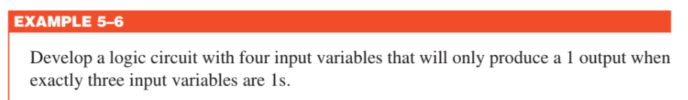

Implementing Combinational Logic

Slide 15
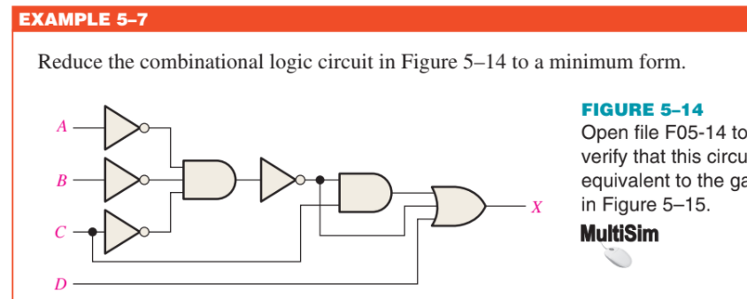
Implementing Combinational Logic

Slide 16
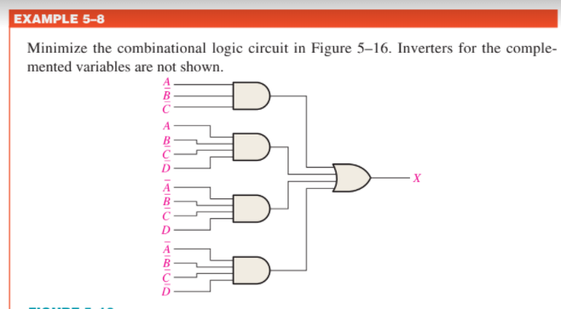
Implementing Combinational Logic

Slide 17
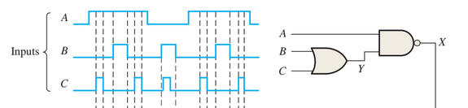
Pulse Waveform Operation

Slide 18
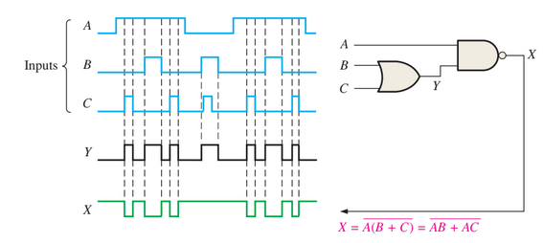
Pulse Waveform Operation

Slide 19
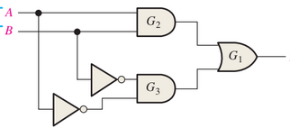

Pulse Waveform Operation

Slide 20
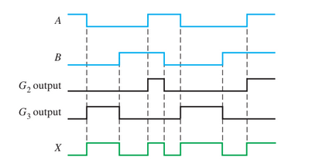
Pulse Waveform Operation

Slide 21
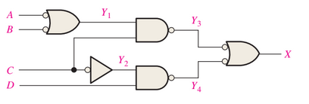
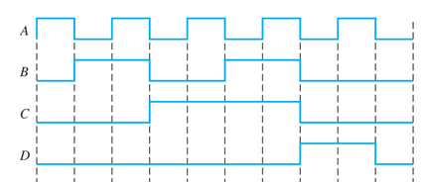
Pulse Waveform Operation

Slide 22
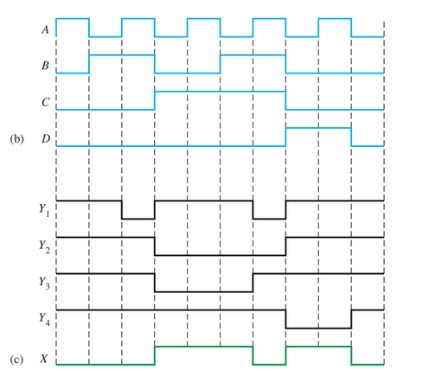
Pulse Waveform Operation

Slide 23
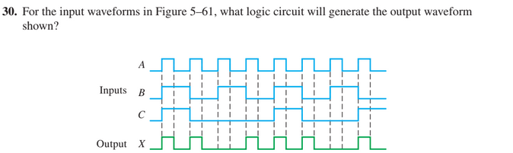
Pulse Waveform Operation

Slide 24
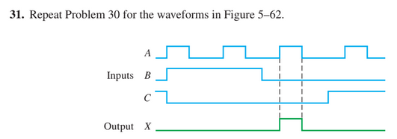
Pulse Waveform Operation

